Slide 1
Tommy John Surgery Prediction
Ben G, Vaasu G, Ethan H

Slide 2
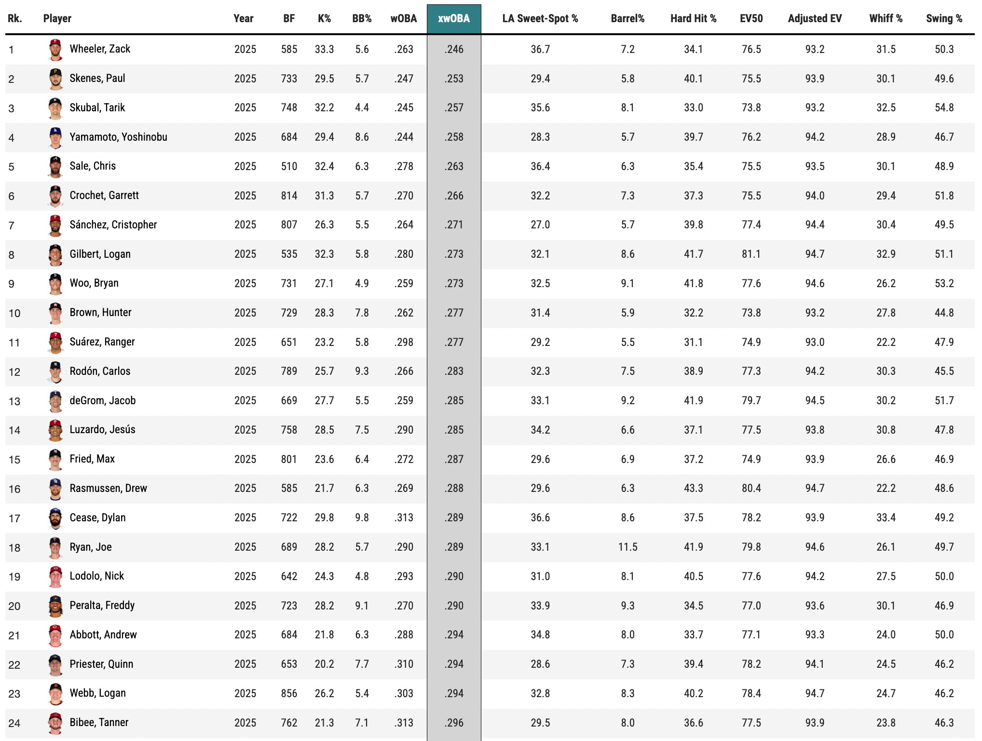
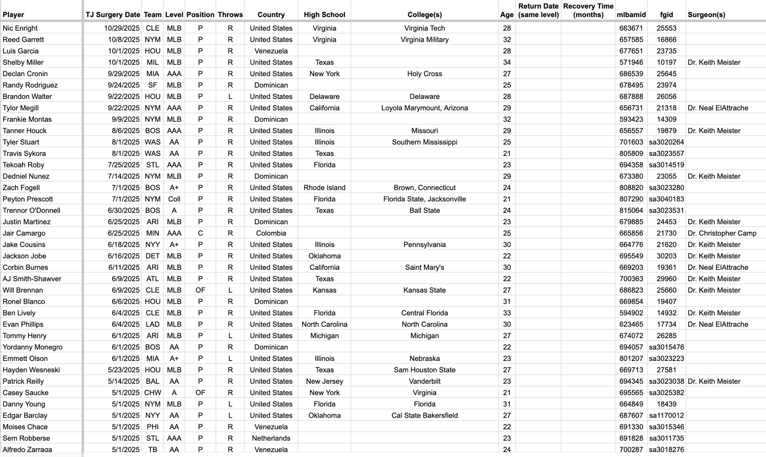
Data Sources

Slide 3
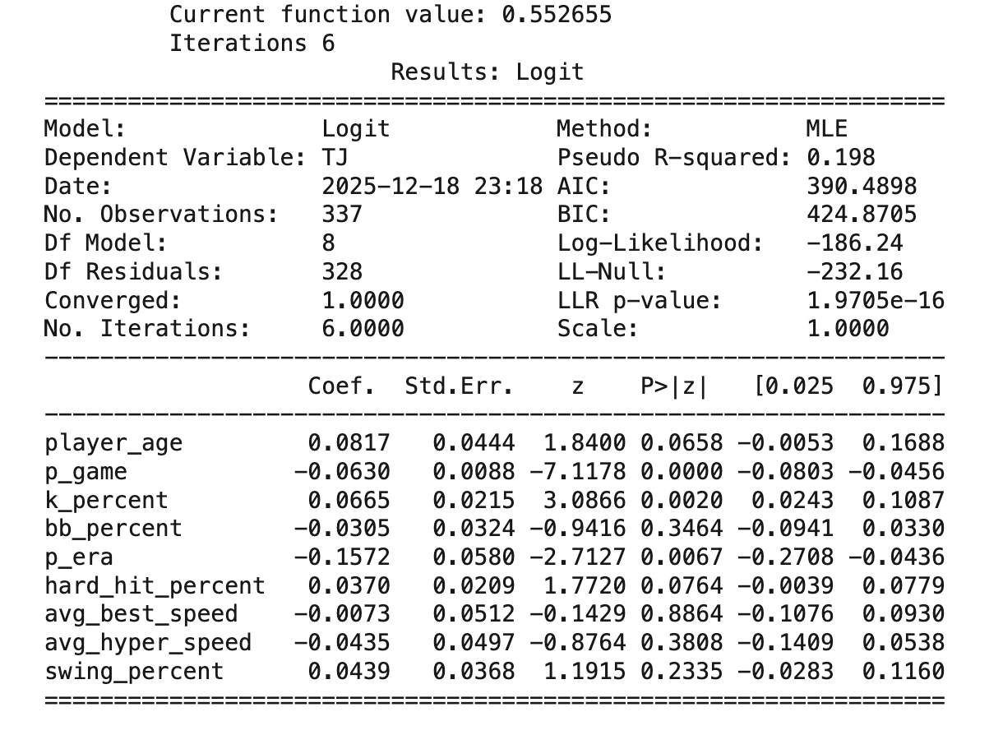
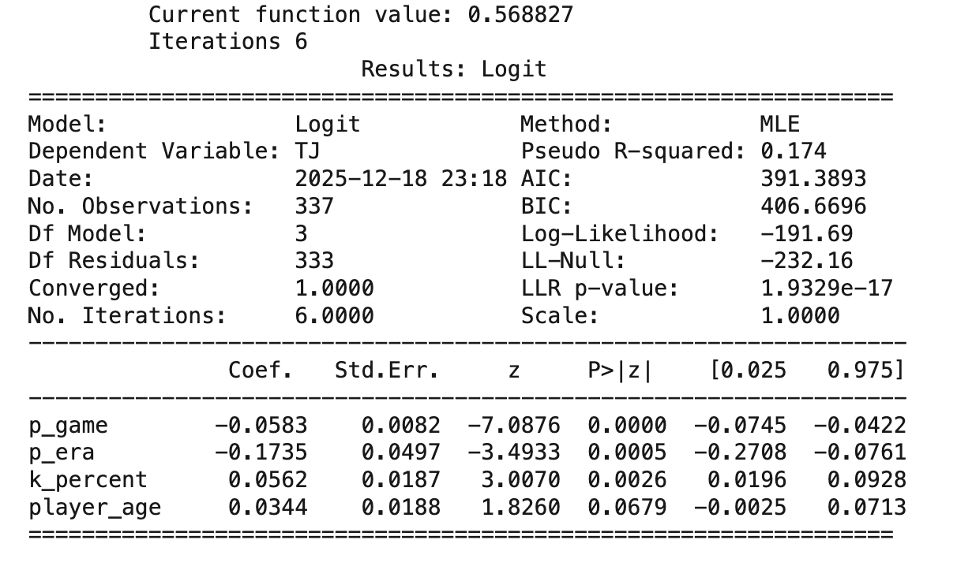
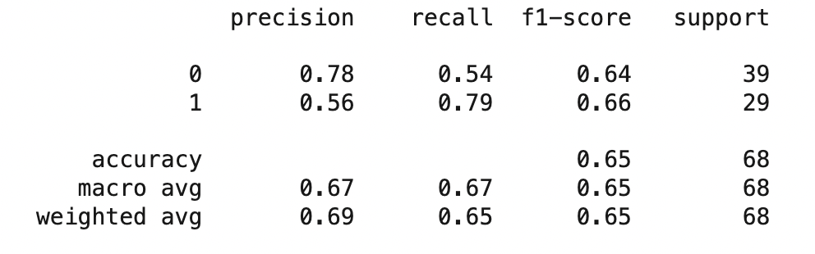
Classifier Evaluation, Model, and Training
Logistic Regression Models

Slide 4
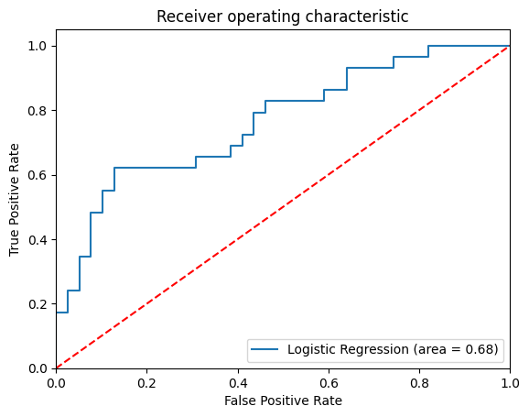
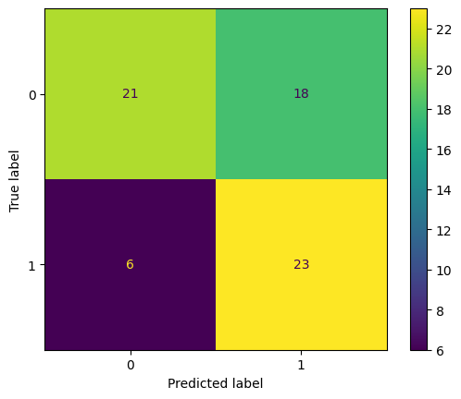
Results: Model performance
Confusion matrix
ROC graph

